Slide 1
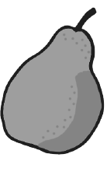
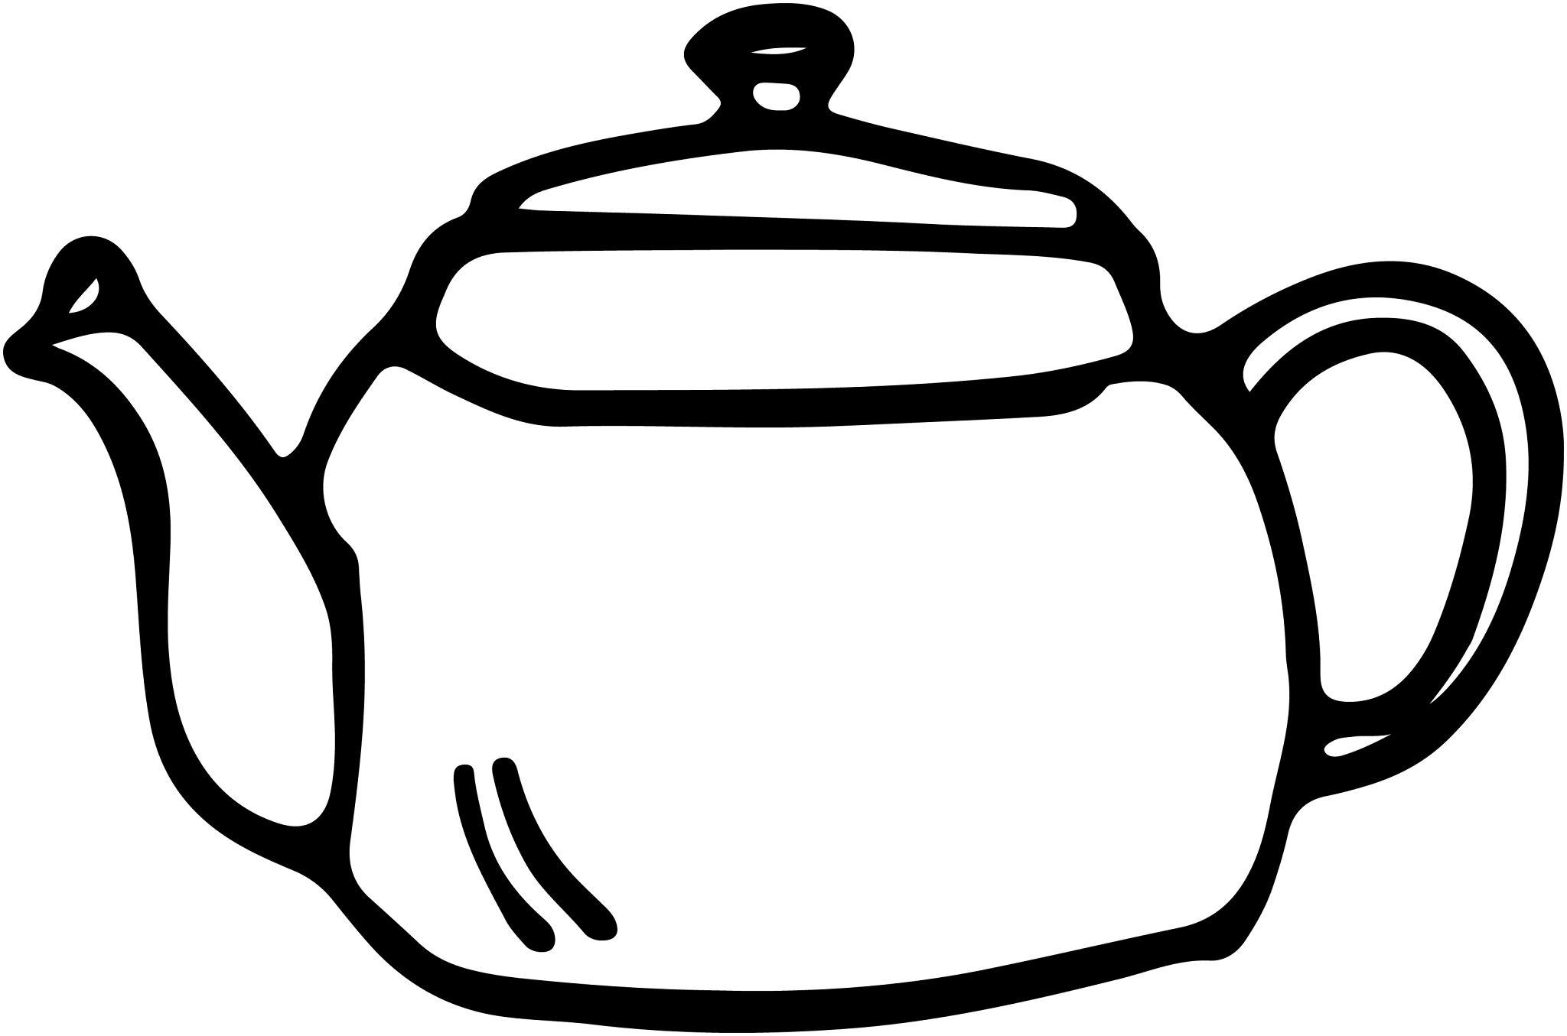
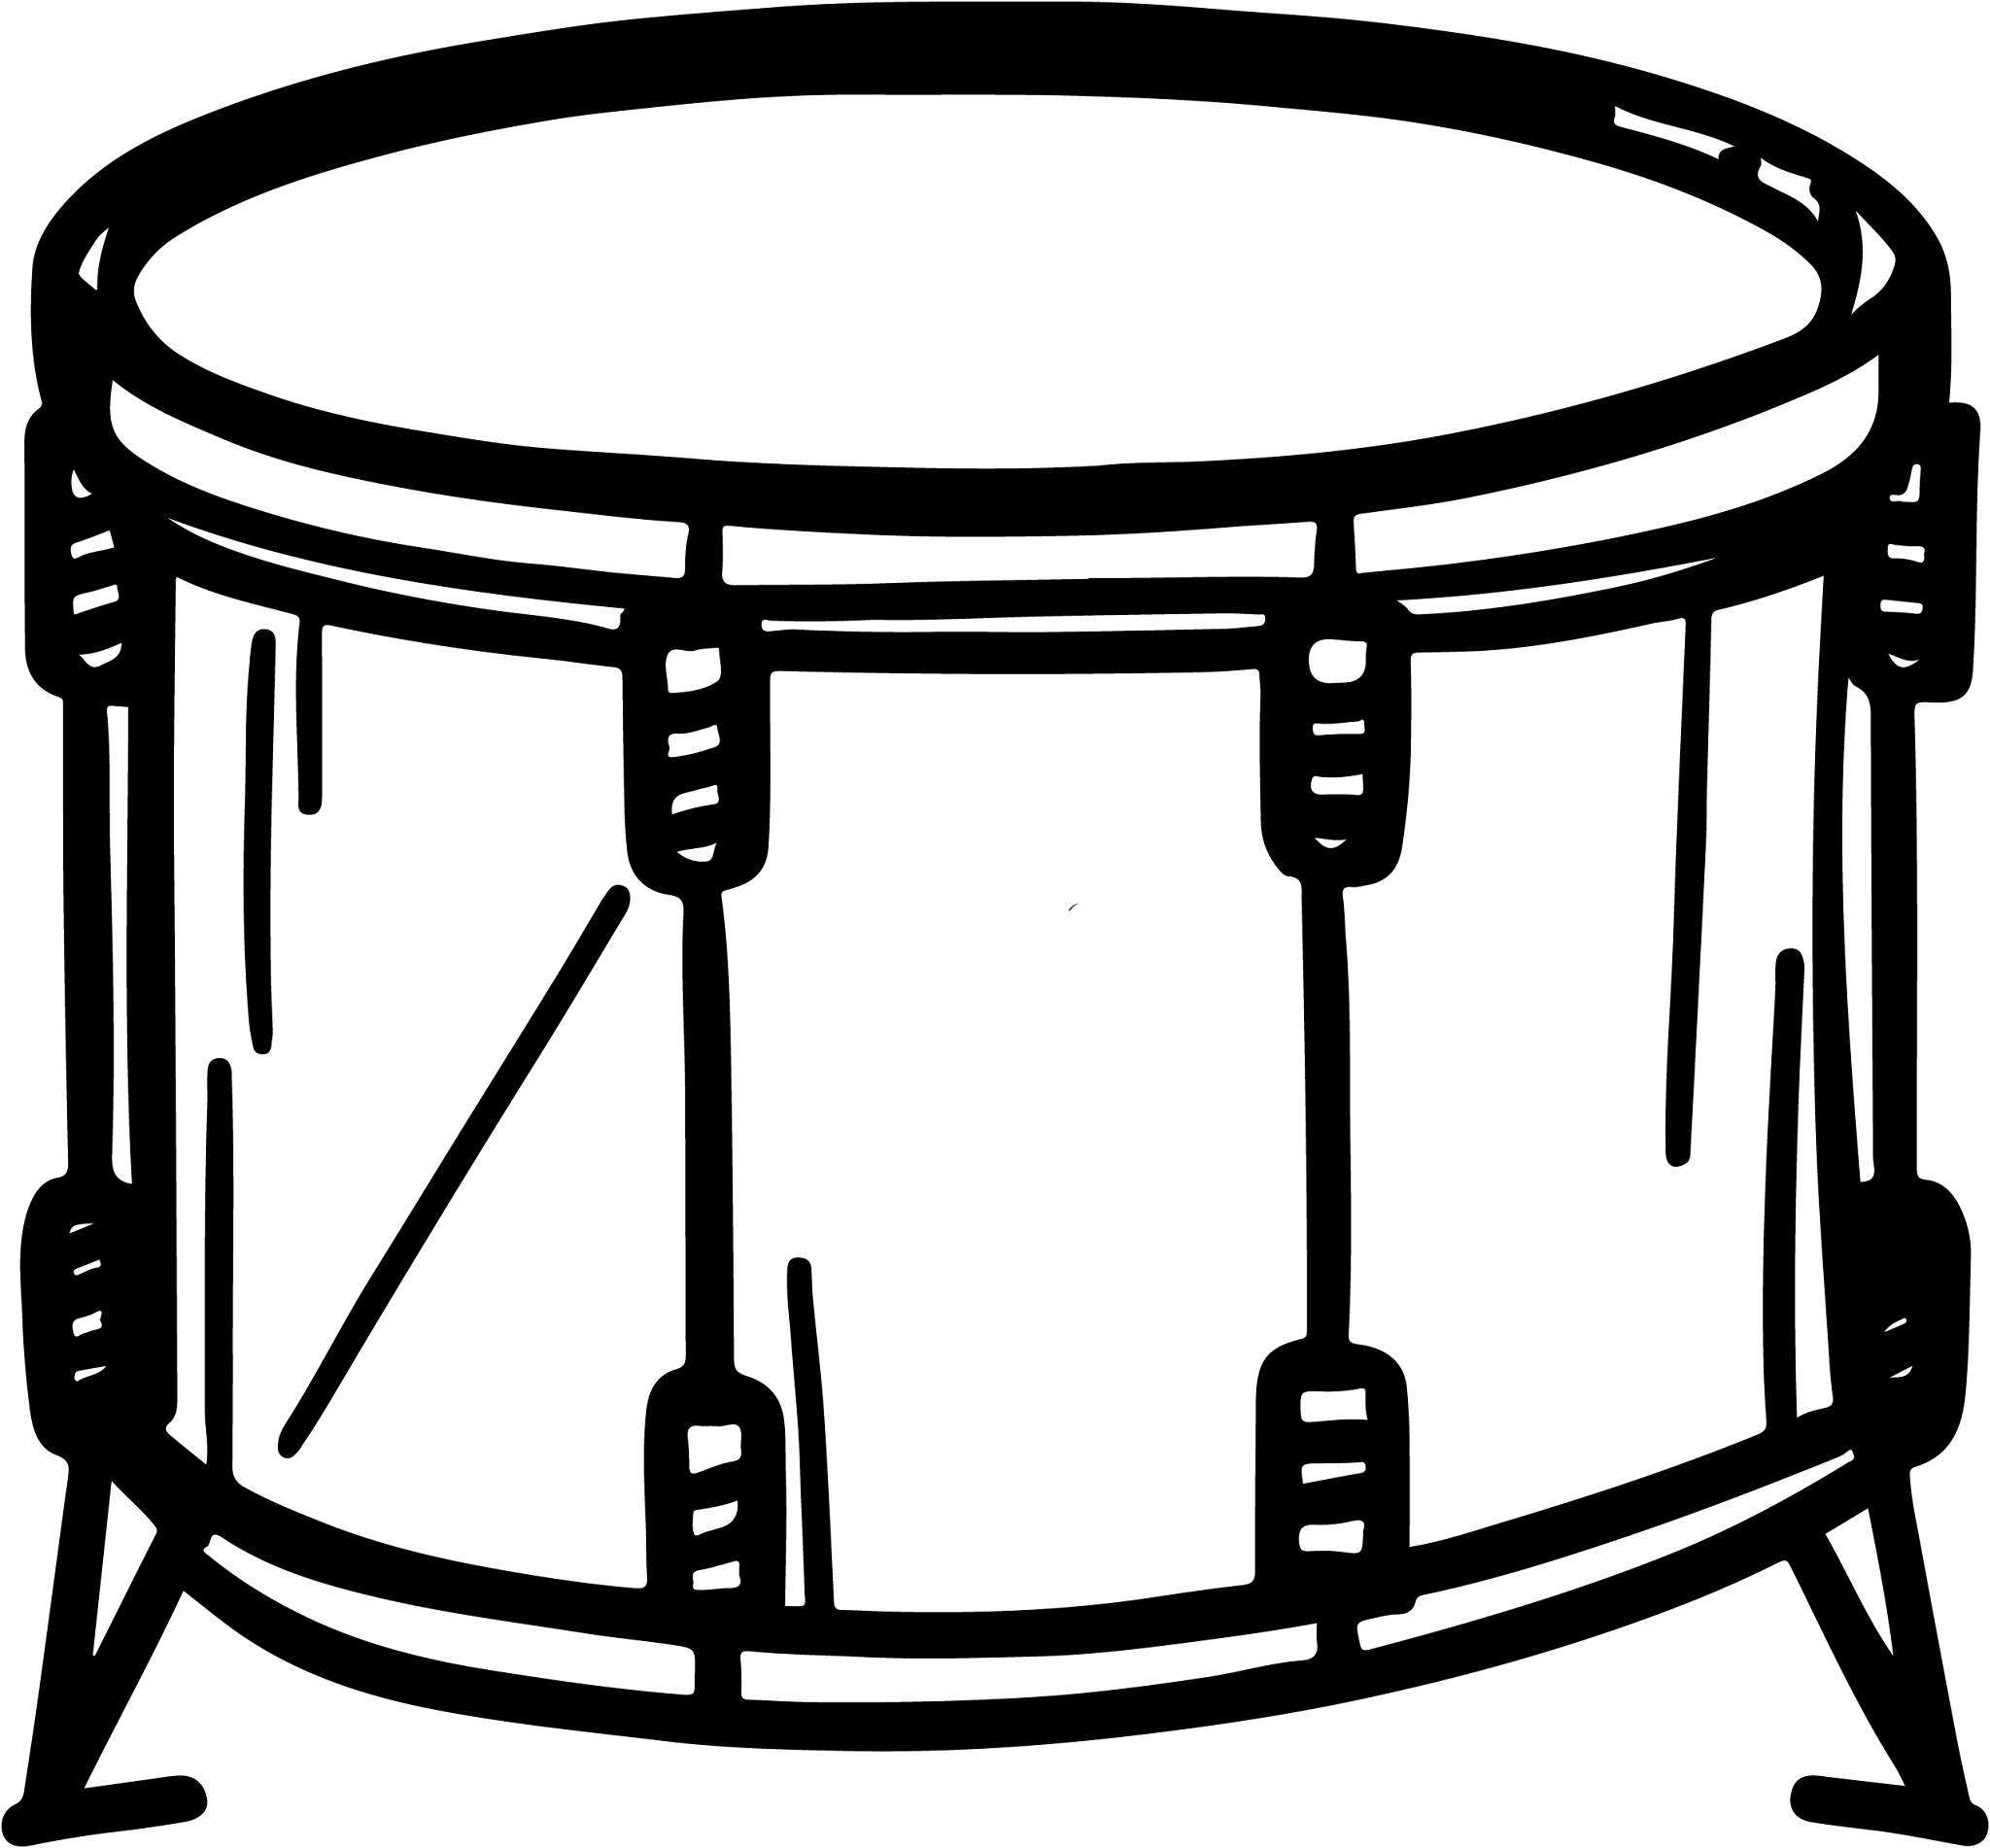
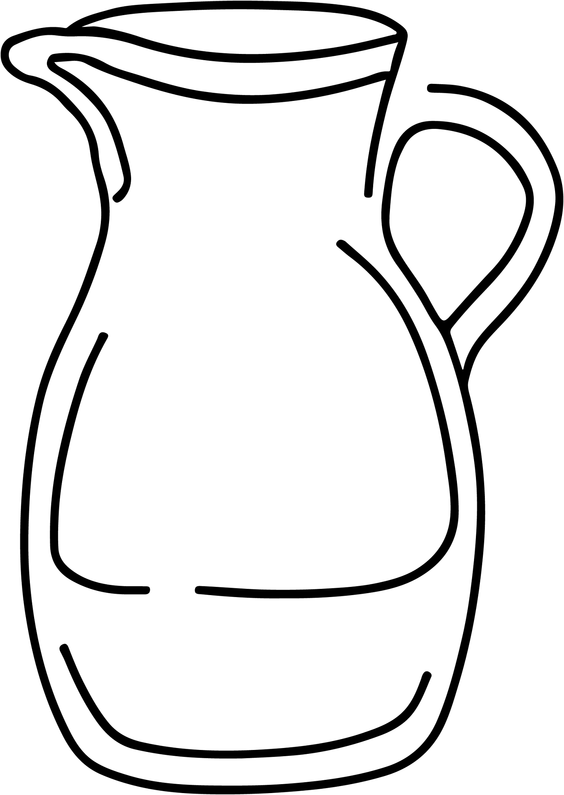
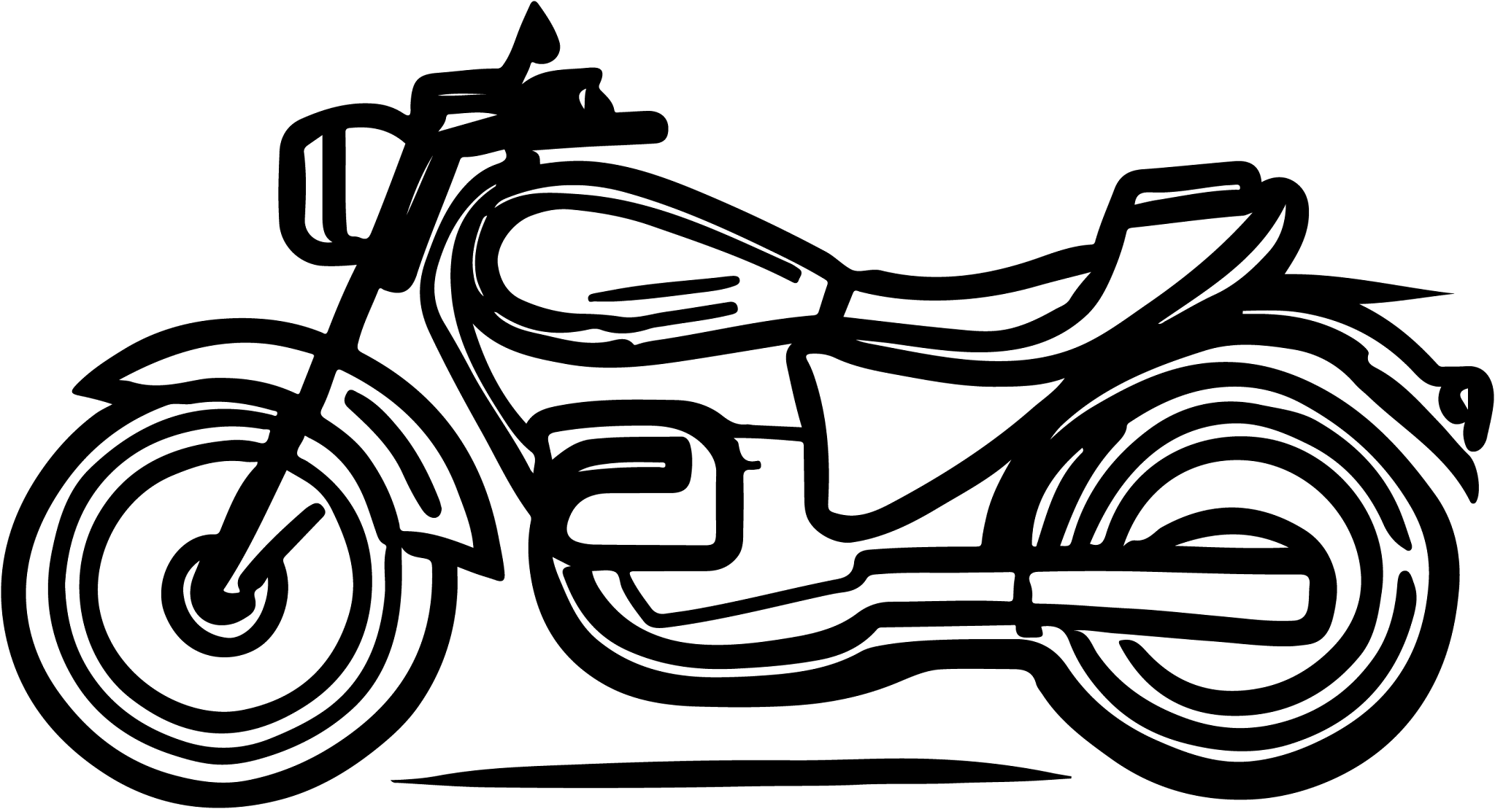
Securing understanding of place value in metric units
Task A: Convert metric measures using place value
1) Convert 7 km into:
a) metres
b) centimetres
c) millimetres
7000 m
 | kilo |  |  | metres |  | centi | milli
 | 7 | 0 | 0 | 0 | 0 | 0 | 0
700 000 cm
7 000 000 mm
2) Convert 425 ml into litres.
 |  | kilo |  |  | litres |  | centi | milli
 |  |  |  |  | 0 | 4 | 2 | 5
.
0.425 litres
3) What is the mass of this pear in kilograms?
 |  | kilo |  |  | grams |  | centi | milli
 |  | 0 | 1 | 6 | 3
.
163 g
0.163 kg
4) What is the capacity of this teapot in ml?
 |  | kilo |  |  | litres |  | centi | milli
 |  |  |  |  | 1 | 1 | 5 | 0
.
1.15 litres
5) Match the objects with all the possible measures.
a) 0.0063 g
d) 6300 g
b) 630 km
f) 0.63 litres
c) 6.3 litres
d) 6300 g
mass of a drum
6.3 kg
e) 6.3 km
capacity of a jug
630 ml
f) 0.63 litres
i) 6300 m
g) 63 000 litres
e) 6.3 km
h) 630 g
distance a motorcycle travels
6 300 000 mm
i) 6300 m

Slide 2
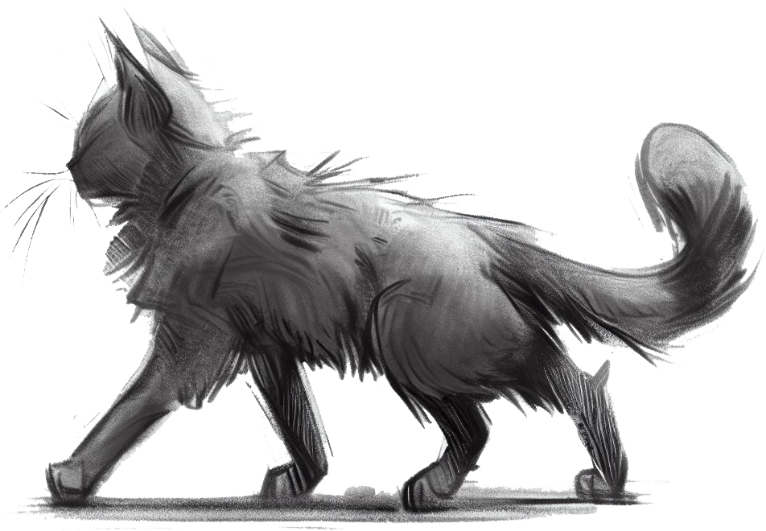
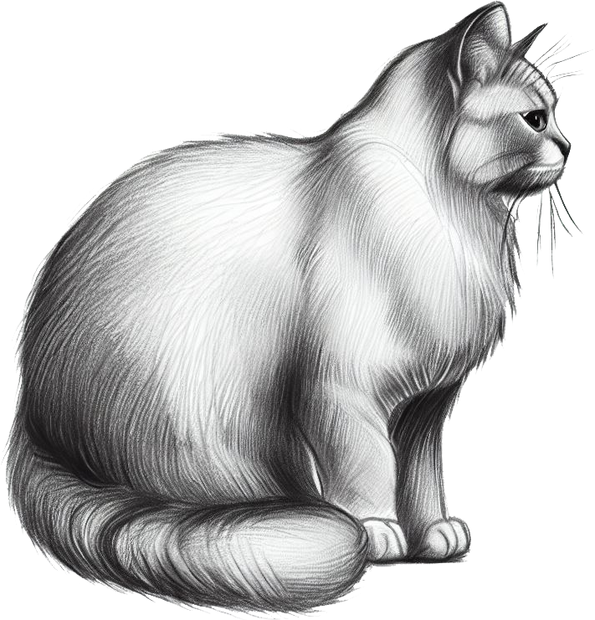
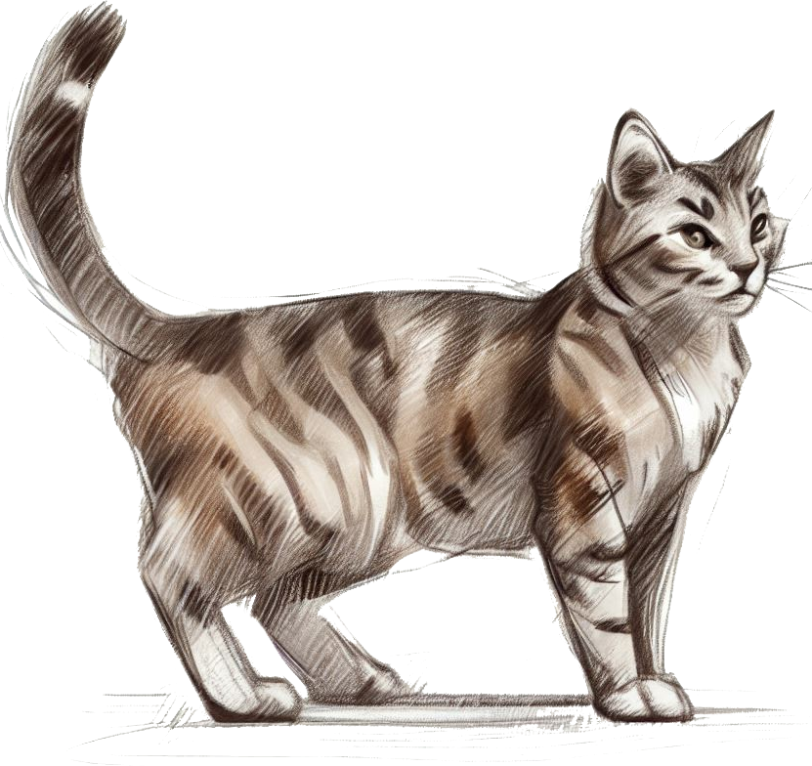
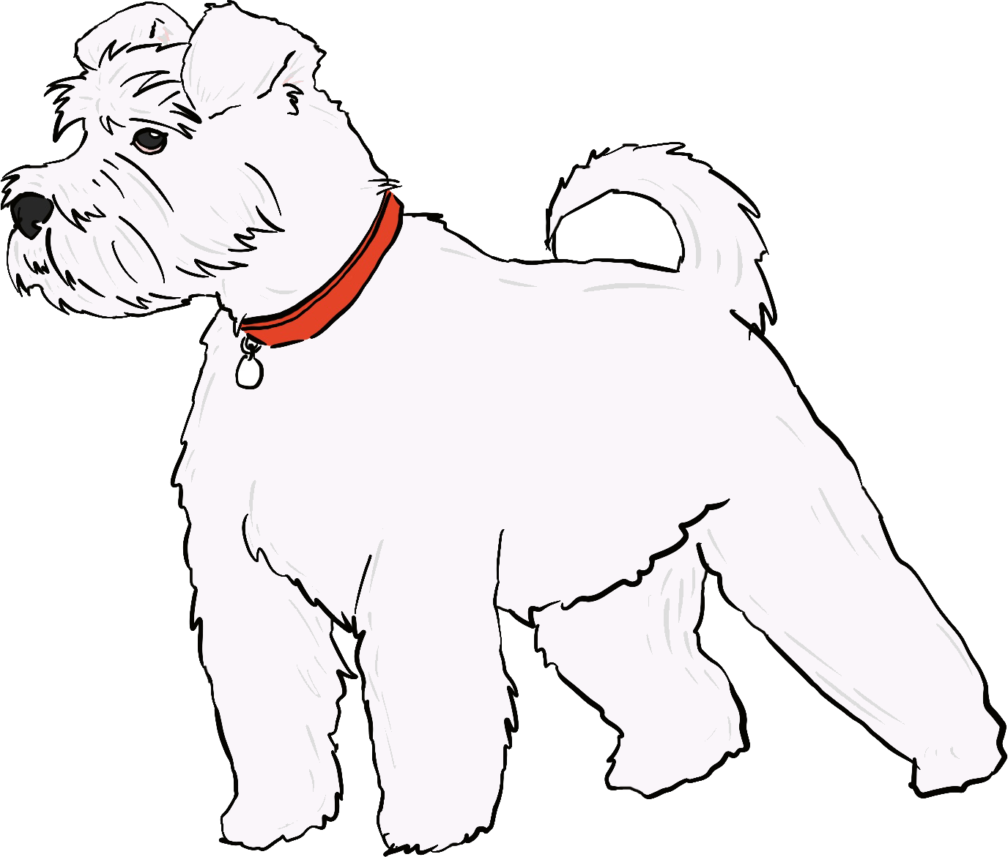
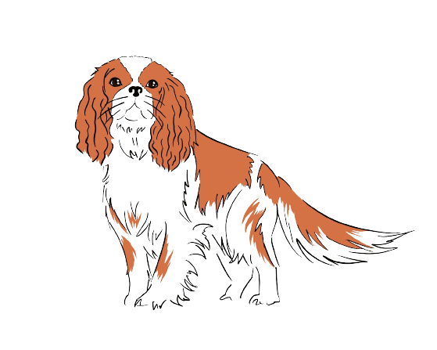
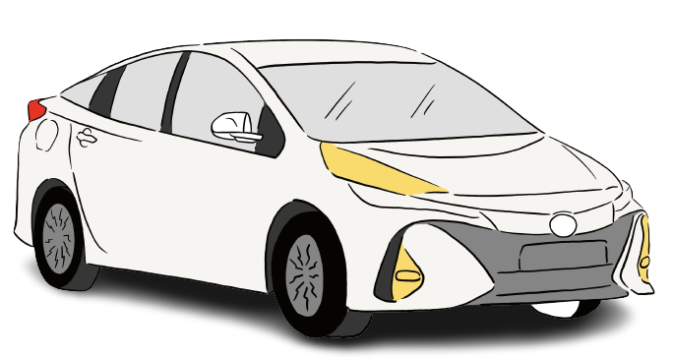
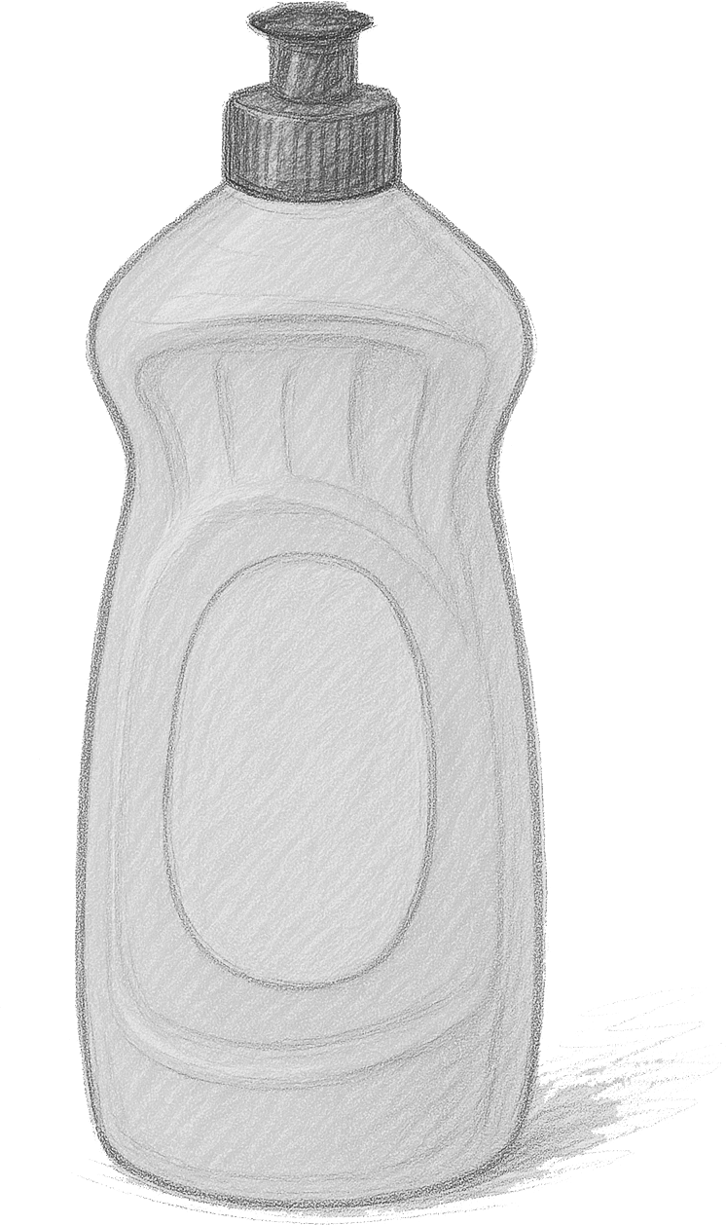

Securing understanding of place value in metric units
Task B: Use conversion to compare different measures
1) Which of these cats is the longest?
2) Which of these dogs has a greater mass?
107 cm
1009 mm
1.06 m
6500 g
7 kg
1070 mm
1009 mm
1060 mm
6500 g
7000 g
This cat is the longest.
This dog has the greater mass
3) The 1.3 litre bottle has a larger capacity. What number could go onto the smaller bottle?
4) A different car has a greater mass than this car.
2300 kg
Any number less than 1300 ml
1.3
litres
Write down a possible mass for this other car in grams.
ml
Any number greater than 2 300 000 g
5) Place these distances in order of size, smallest first.
a
b
c
d
e
f
1.8 km
7500 cm
180 m
75 mm
75 m
1.8 cm
1800 m
75 m
180 m
0.075 m
75 m
0.018 m
f
d
b
c
a
shortest
e
longest
6) Fill in each blank with any number that makes the descriptions underneath correct.
900 g
kg
kg
18 500 g
7.5 litres
ml
lighter
heavier
lighter
heavier
smaller
larger
Any number greater than
0.9 kg
Any number less than
18.5 kg
Any number greater than 7500 ml
v2.1

Slide 3
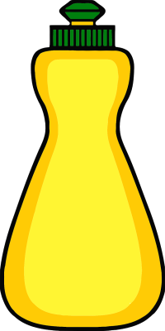
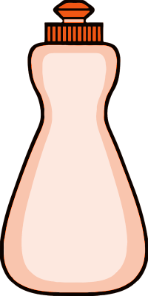
Securing understanding of place value in metric units
Task B: Use conversion to compare different measures
1) Which of these cats is the longest?
2) Which of these dogs has a greater mass?
107 cm
1009 mm
1.06 m
6500 g
7 kg
1070 mm
1009 mm
1060 mm
6500 g
7000 g
This cat is the longest.
This dog has the greater mass
3) The 1.3 litre bottle has a larger capacity. What number could go onto the smaller bottle?
4) A different car has a greater mass than this car.
2300 kg
1.3
litres
Write down a possible mass for this other car in grams.
Any number less than 1300 ml
ml
Any number greater than 2 300 000 g
5) Place these distances in order of size, smallest first.
a
b
c
d
e
f
1.8 km
7500 cm
180 m
75 mm
75 m
1.8 cm
1800 m
75 m
180 m
0.075 m
75 m
0.018 m
f
d
b
c
a
shortest
e
longest
6) Fill in each blank with any number that makes the descriptions underneath correct.
900 g
kg
kg
18 500 g
lighter
heavier
lighter
heavier
Any number greater than
0.9 kg
Any number less than
18.5 kg
7.5 litres
ml
smaller
larger
Any number greater than 7500 ml
v2.1

Slide 4
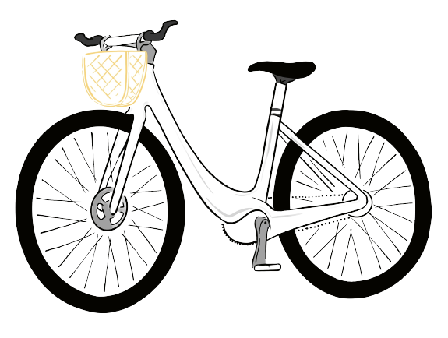
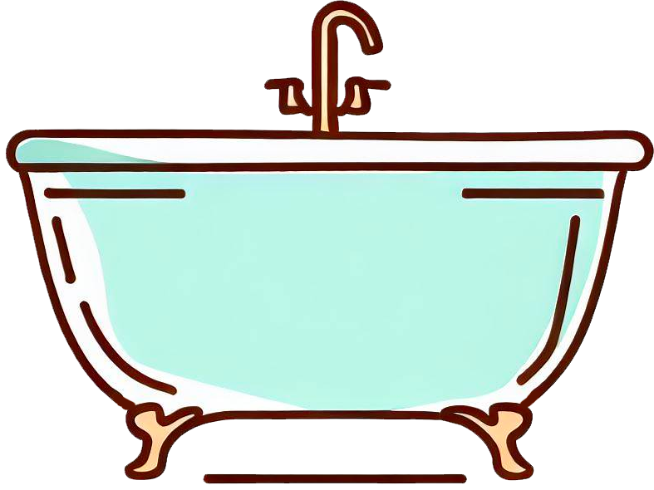
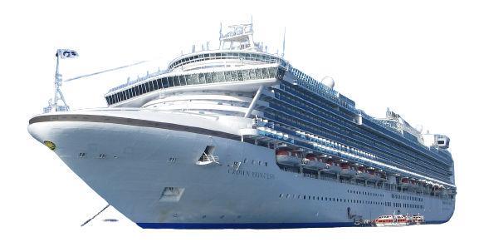
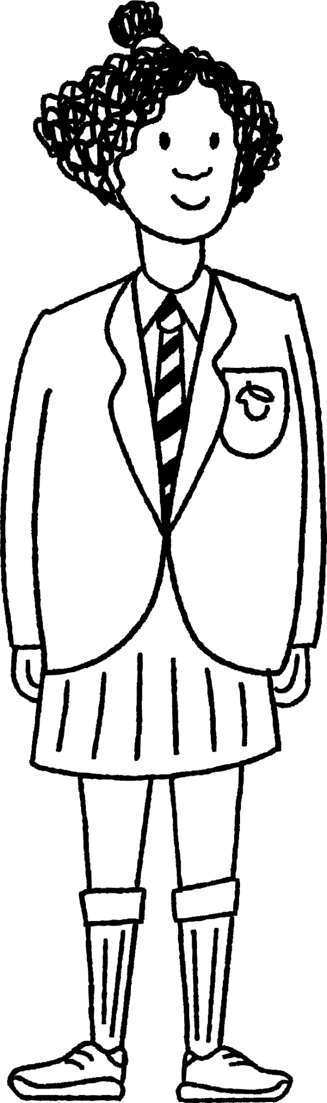
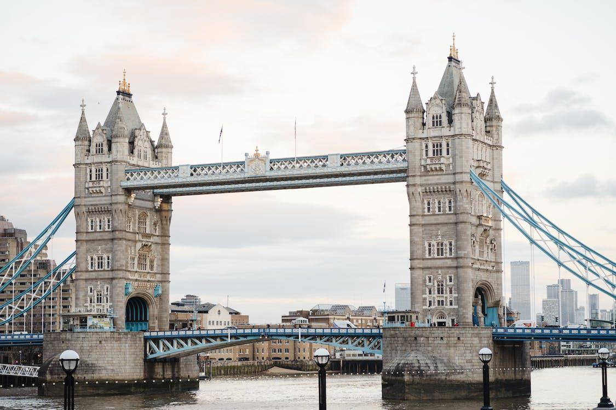
Securing understanding of place value in metric units
Task C: Check if conversions of real examples are sensible
1) The mass of the bike below is 14 570 g.
Which of the values below also represents this bike?
2) The capacity of this bathtub when full is 182 000 ml.
Which of the values below also represents the bathtub?
1.457 kg
14.57 kg
145.7 kg
18 200 litres
182 cl
18 200 cl
18.2 litres
182 litres
3) This ship is 0.29 km long and has a mass of 113 000 000 kg.
Fill in the blanks below with the correct numbers and metric units.
290
m
29 000
cm
113 000 000 000
g
(that is 9 zeros)
4) Write down all the possible units of measure that could go in the blanks to make the descriptions underneath correct.
length of Tower Bridge, London
the height of Izzy
24 400 cm
225
16.5
0.0017 km
km
cm
mm
Shorter
Longer
Shorter
Taller
244 m
1.7 m = 170 cm

